Slide 1

Building A weather App
Developed By
Suchitra Srivastava

Slide 2
Weather App
Weather forecasting App is the application of current technology and science to predict the state of the atmosphere /weather for a current/future time of a given location.

Slide 3
Overview Of The Presentation
Title
Why we need weather forecast app
Working of the project
Technology used
How to handle error
Architecture Diagram

Slide 4
Title
The proposed App provide the current weather of cities all around the world
In this system the user can view Weather for which they search for
The proposed App uses OpenWeatherMap API and the API key

Slide 5
Why we need weather app ?
Daily planning
Event Planning
Travel Planning
Agriculture and Farming
Decide what to wear

Slide 6
Working of the project
The user is asked to enter the name of the city
User then clicks on search button which further call OpenWeatherMap API
When we input name of city we can easily see
Current Temperature
Humidity
Wind speed
Description

Slide 7
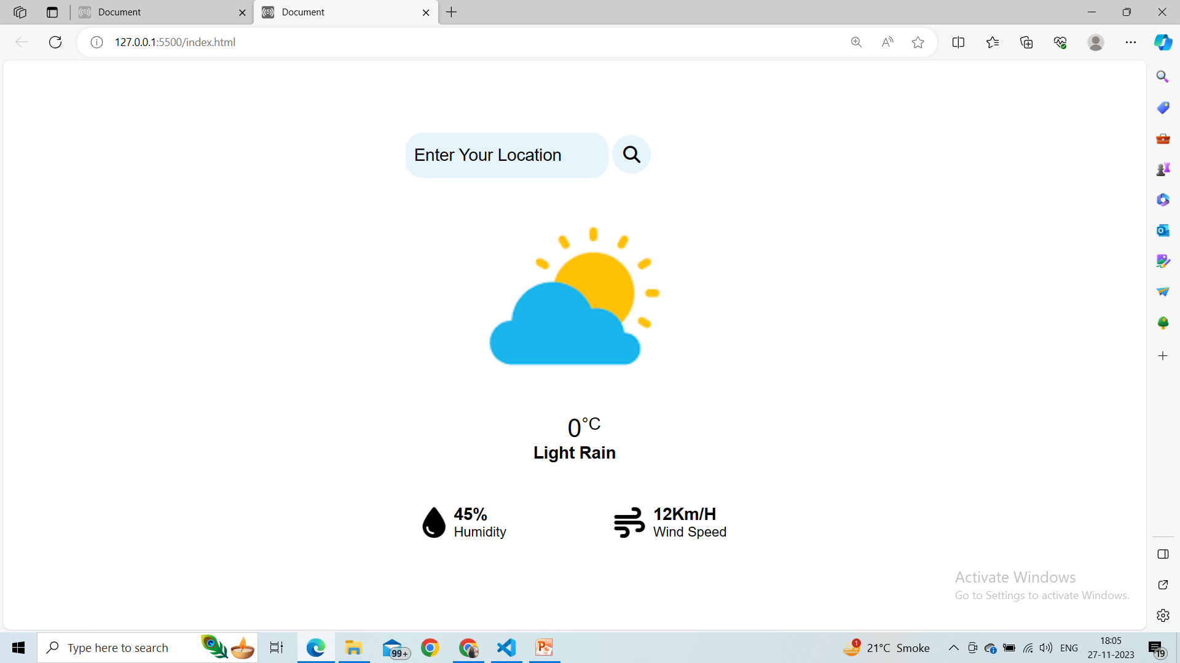

Slide 8
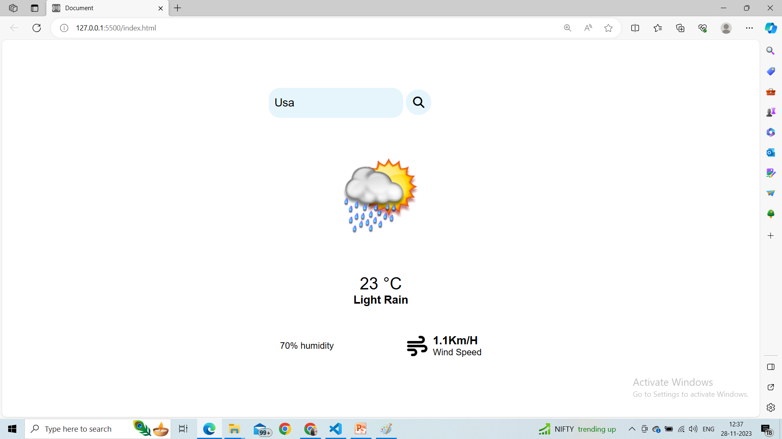

Slide 9
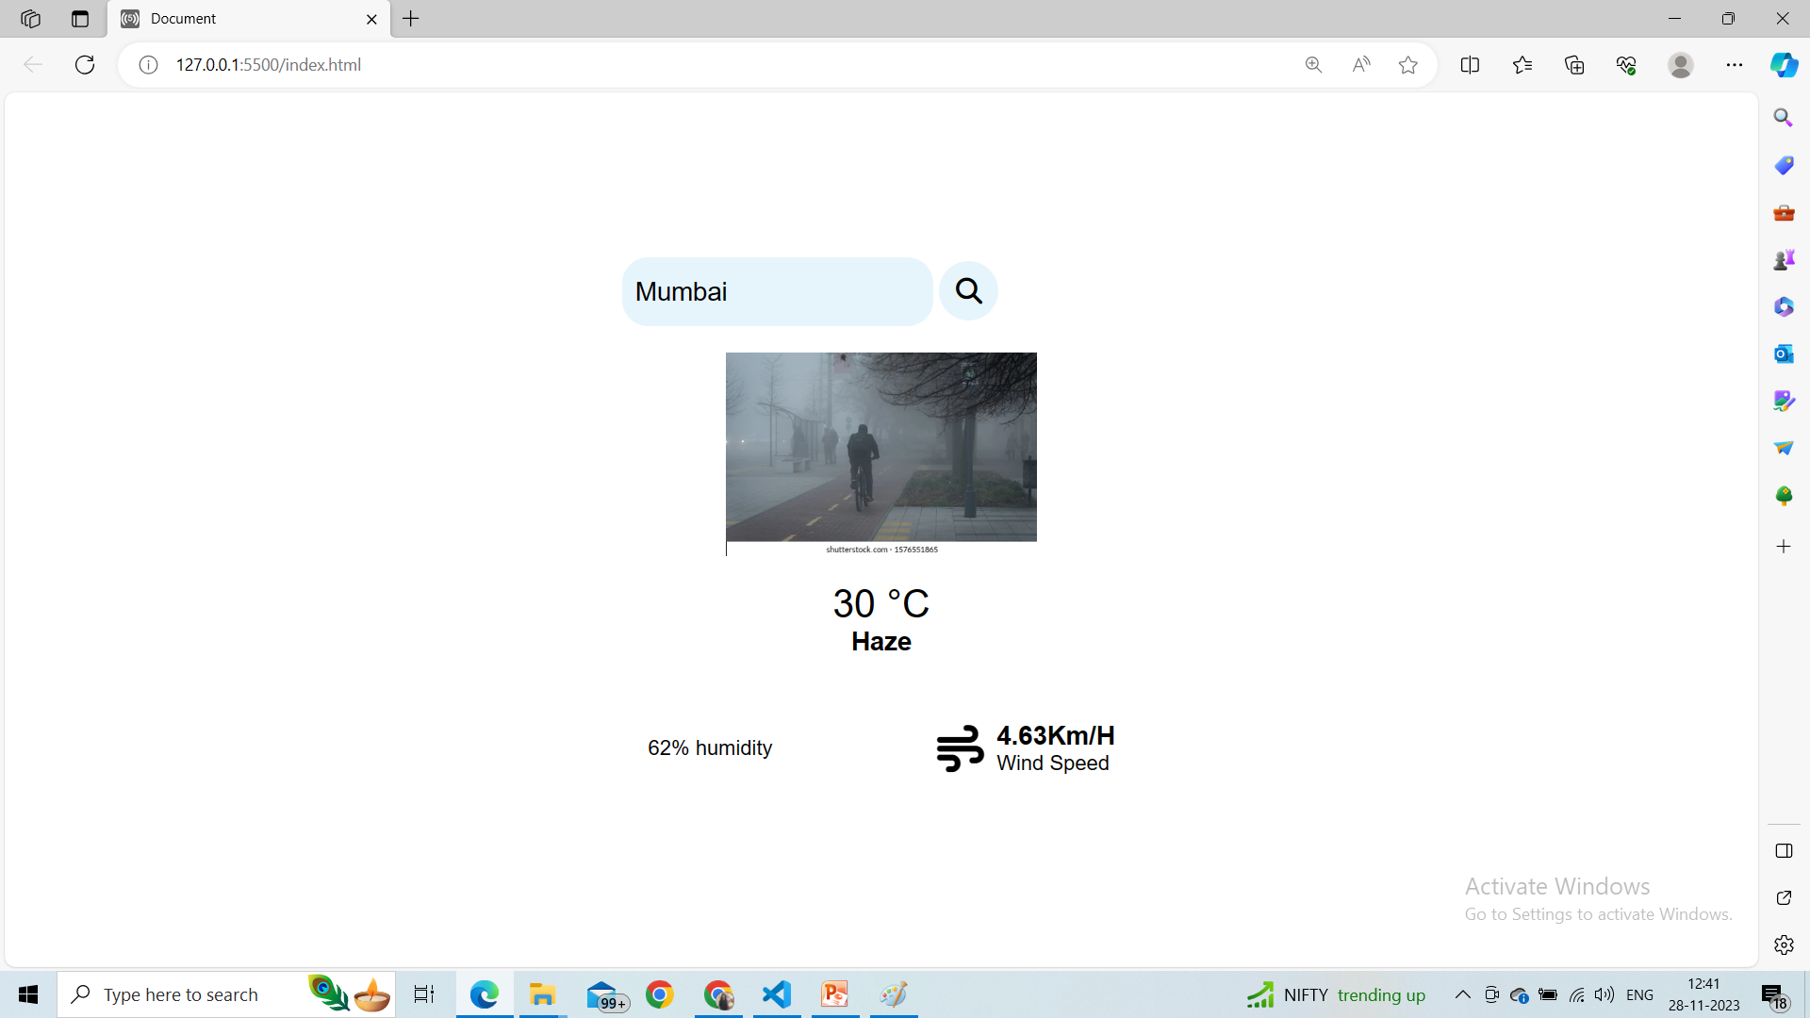

Slide 10
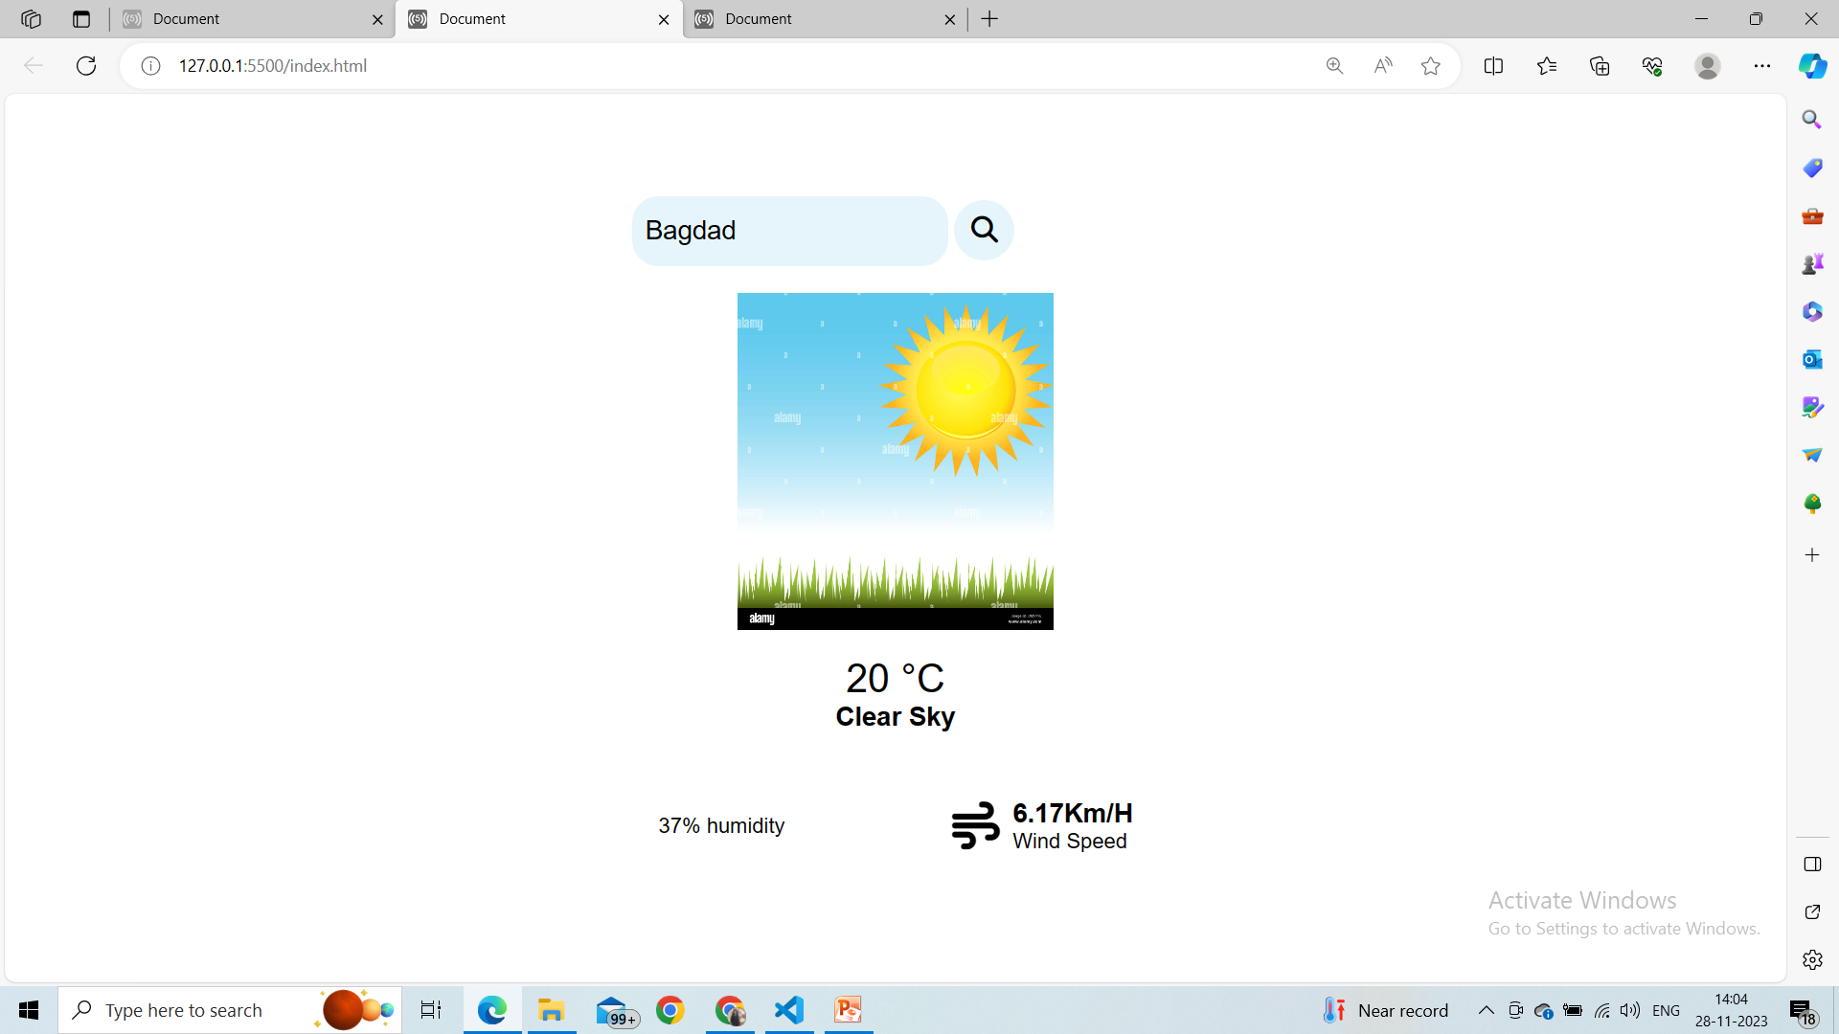

Slide 11
Programming Languages used
HTML
CSS
JavaScript
Text Editor
Visual Studio Code
API
OpenWeatherMap API

Slide 12
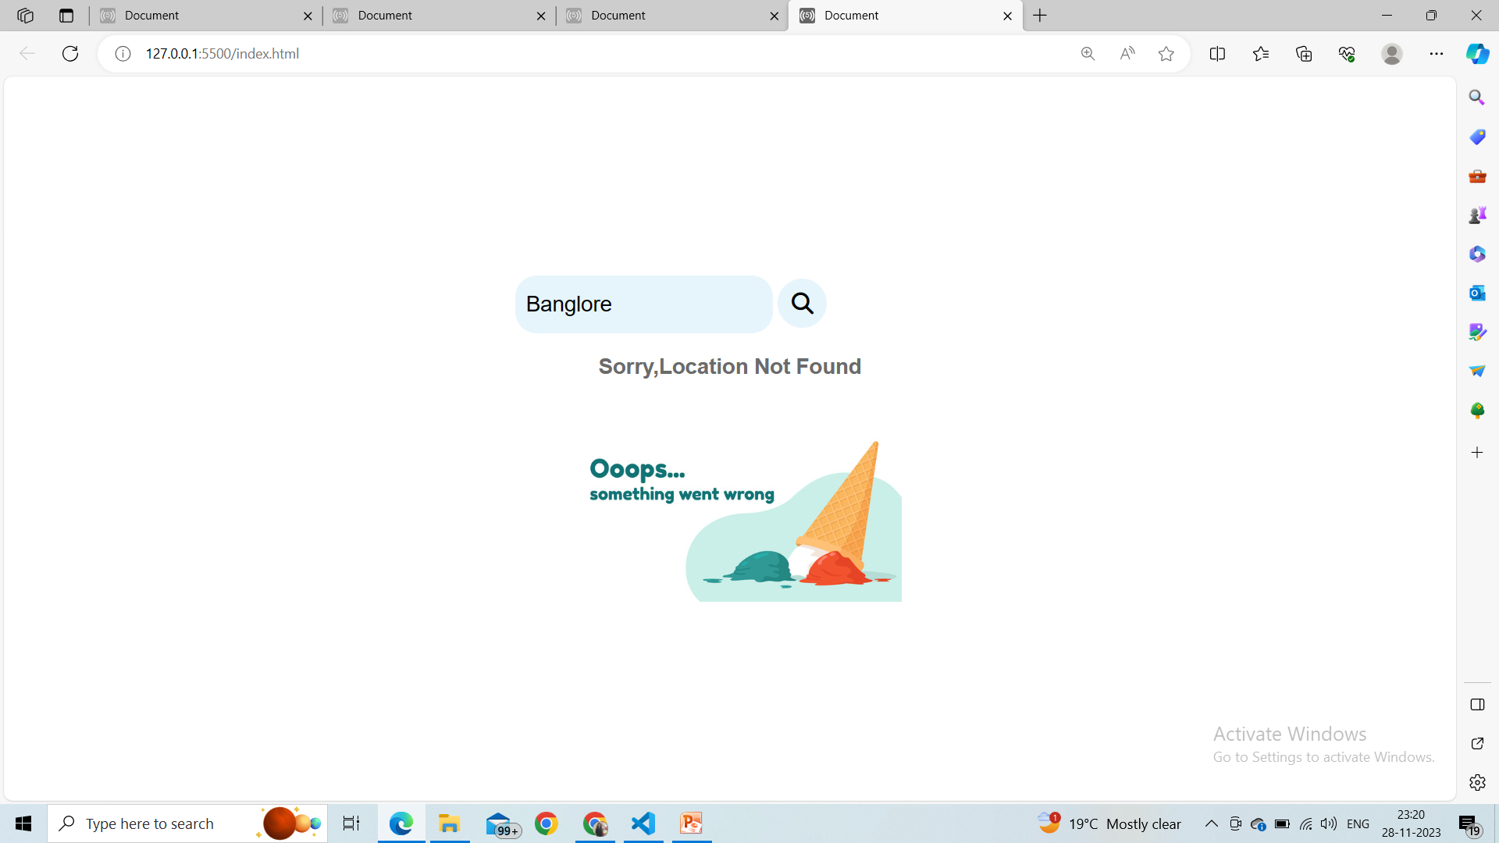
How To Handle Error

Slide 13
Architecture Diagram
Enter city Name
Request For Weather
Fetch Data From API
Current Weather Details

Slide 14

Thank You
Any Question ?

